Slide 1
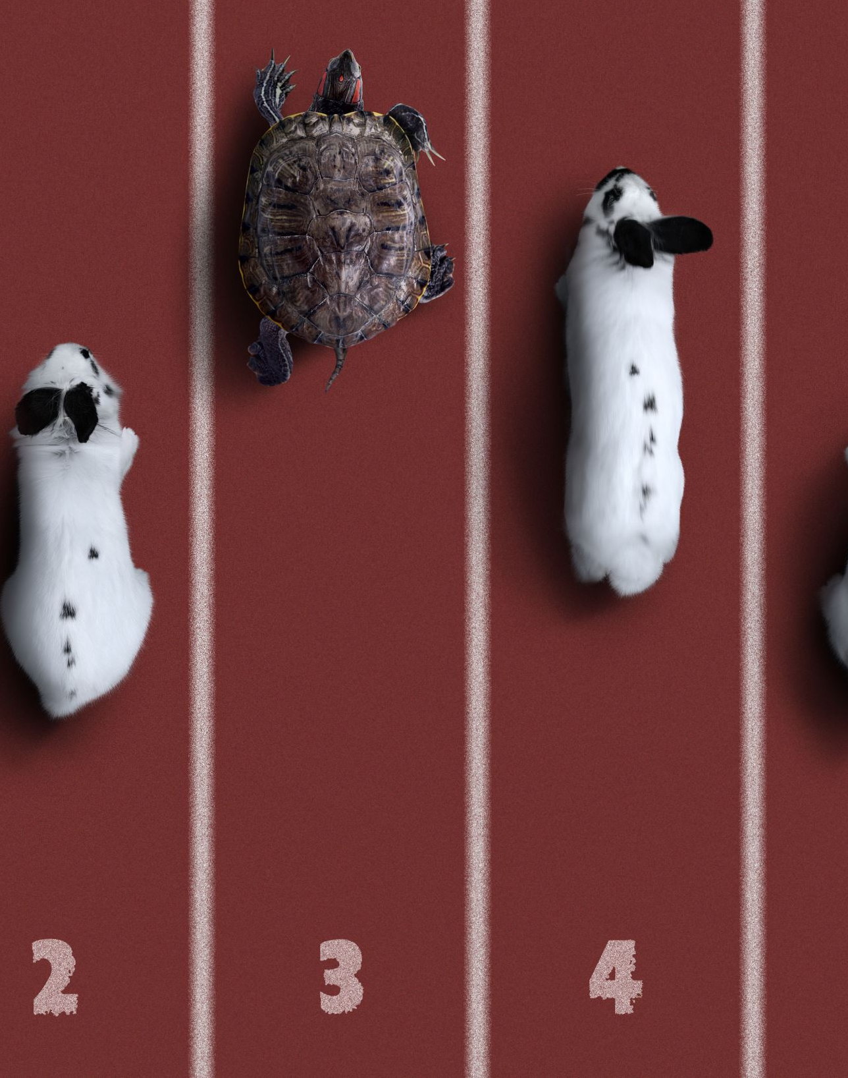
ENPM 673 TURTLEBOT CHALLENGE Group -13

Slide 2
Group Members
Varun Lakshmanan - 120169595
Harshavarthan Varatharajan - 120258688
Nitish Ravisankar Raveendran - 120385506
Sai Jagadeesh Muralikrishnan - 120172243

Slide 3
INTRODUCTION
This Project involves using turtlebot3 to navigate through a series of papers while avoiding obstacles and reacting to stop signals.
We achieved this using fundamental perception techniques which will be discussed in upcoming slides
Here is basic idea of what is going to be shown in upcoming slides:
1. Creating horizon line.
2. Paper Detection
3. Stop sign detection.
4. Optical flow.
5. Testing in simulation and real-world environment.

Slide 4
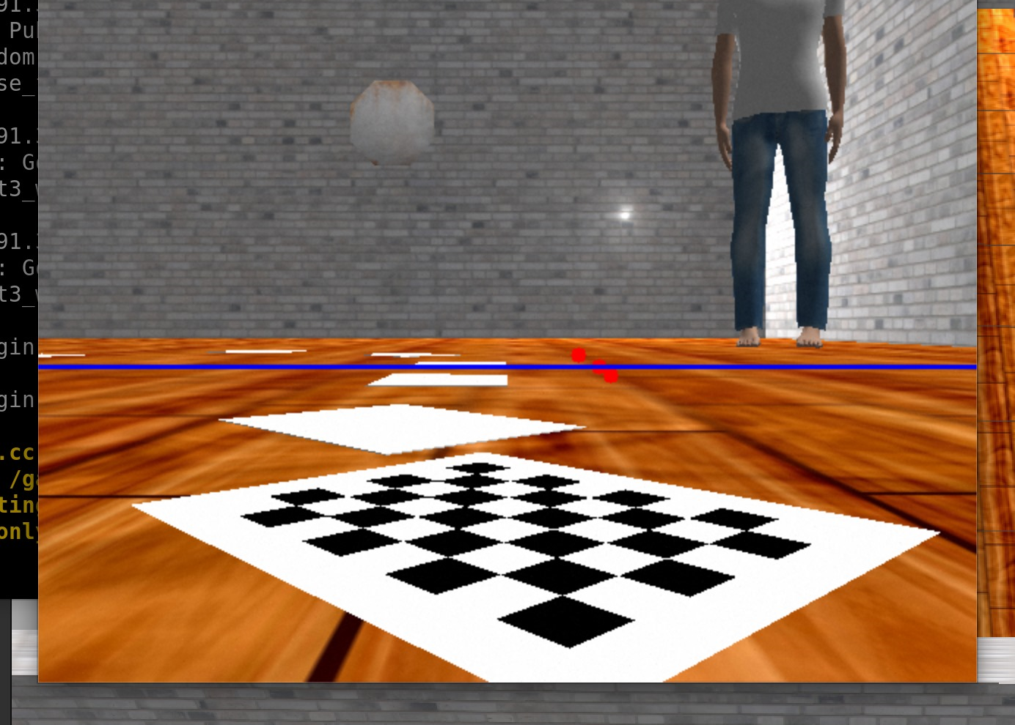
Horizon Line Detection
The Purpose of horizon line detection is act as a reference line for the robot , that distinguishes between ground plane and sky plane. It also helps in lane detection in case of autonomous vehicles.

Slide 5
Pipeline for Horizon line detection
Getting the image feed from the camera
Processing the image by applying grayscaling the image and applying gaussian blur to smoothen the image.
Using canny edge detection to detect the edges
Detecting the lines using hough transform and filtering out the horizontal lines.
Finding the intersection point between the lines
Extracting the y-coordinates from the intersection points
Choosing the most frequently occurring y-coordinate and drawing the horizon line.

Slide 6
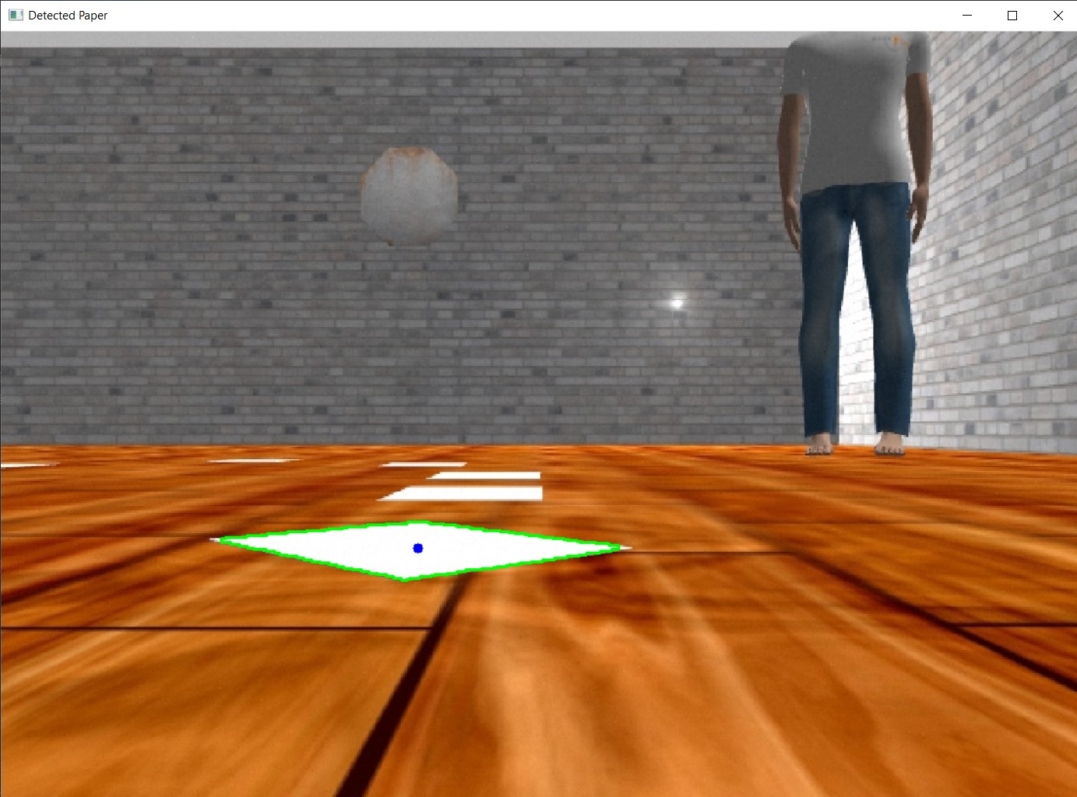
Paper Following
The Purpose of paper following in this project is to make the turtlebot follow a trajectory made by placing series of papers visible below the horizon line.

Slide 7
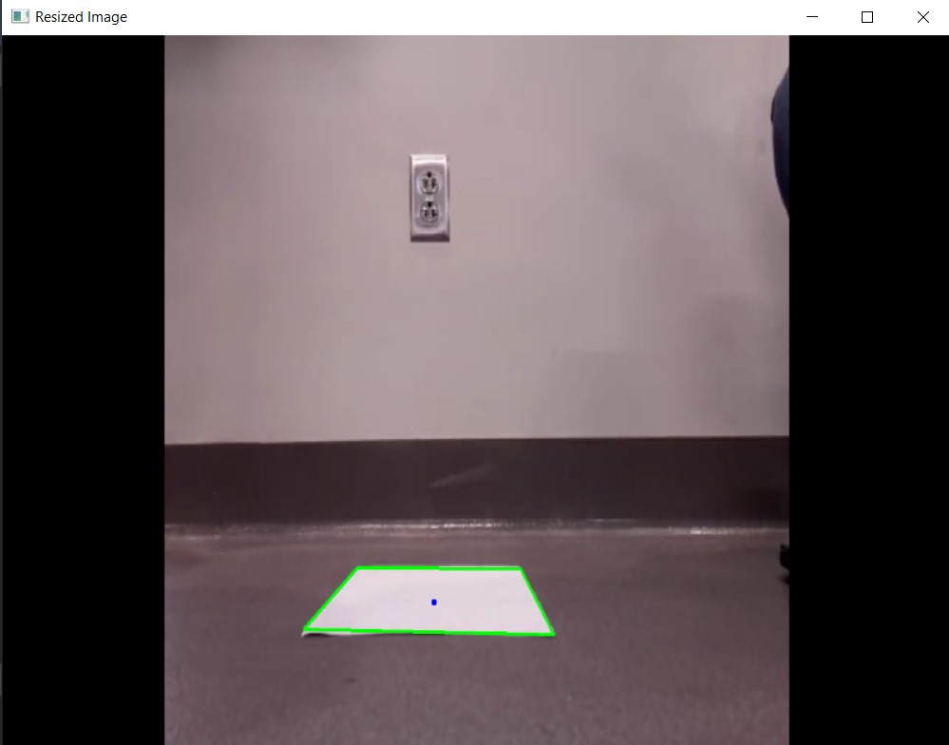
Pipeline for paper following
Getting the image from the camera feed
Pre - Processing the image
Converting the color space to HSV
Applying morphology to the kernel
Detecting the contours and filtering them
Calculating the centroid of largest contour and determine the position of the paper with respect to camera
Contours and centroid is drawn on the image to have a visual feedback and robot follows the paper considering it as path.

Slide 8
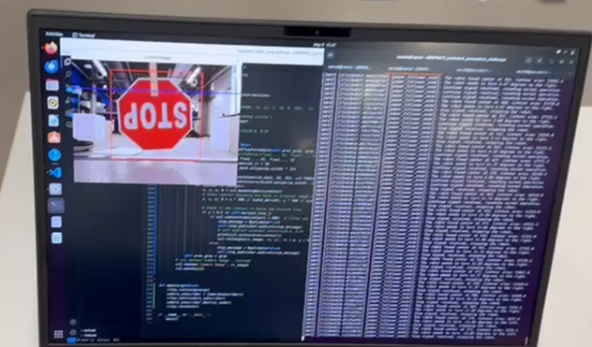
Stop Sign detection
The stop sign detection is done to make the robot stop when a stop sign is visible in the camera feed of the robot.

Slide 9
Pipeline for Stop sign detection
Getting the image from the camera feed and.
Preprocessing the image to grayscale
Loading a pre-trained Haar cascade classifier for detecting stop-sign.
Implementing the Haar cascade classifier to the processed image.
Additional checks to confirm the presence of stop sign.
Stopping the robot when the stop sign is visible in the camera feed.
Drawing Boxes to show the stop signs has been detected.

Slide 10
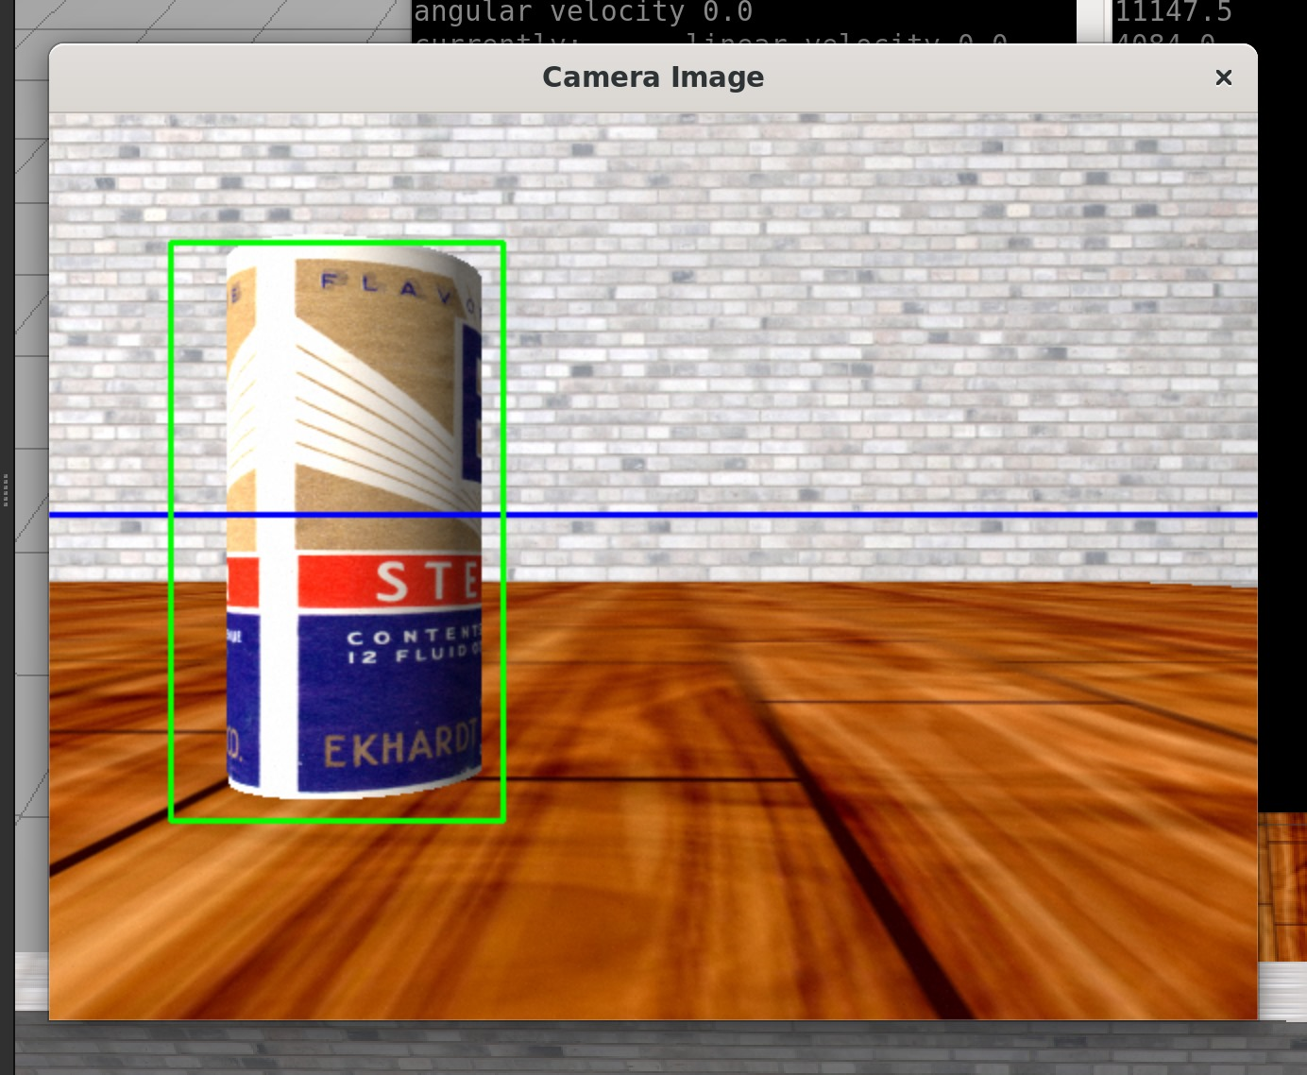
Optical Flow
The Optical flow is done to make the robot detect the moving obstacles on its path.

Slide 11
Pipeline for optical flow
Getting the image from the camera feed.
Pre-processing if not already done.
Using Farneback Method to calculate the flow vector of every pixel
Calculating the magnitude and direction of the flow vectors.
Applying thresholds to the magnitude.
Adjusting thresholds for better detection of obstacles.
Getting feedback from the sensors and applying actions

Slide 12
ROS2 PIPELINE
START
Setting up parameters and creating subscribers and publishers
Receiving the image feed and processing them
Feature detection
Robot begins to follow the paper trail
Check for stop sign or moving obstacles
True
Stop the robot
False
Continue moving the robot

Slide 13
Challenged Faced
False Positives of random objects were detected in real world environment.
False Positives of random objects were detected in real world environment.
Problems occurred when we tried to integrate all the implementations into ROS.

Slide 14
Video Links
Gazebo Simulation
https://drive.google.com/file/d/12pGSvqSViUToGuILA8yy3oCMIlkS39Y1/view?usp=sharing
Hardware Implementation
Perception Hardware implementation.mp4 - Google Drive

Slide 15
Conclusion
Thus, we successfully implemented the fundamental concepts of perception into the turtlebot3 for it to successfully navigate through the series of papers placed, while avoiding the moving obstacles on it path and responding to the stop signal.

Slide 16

THANK YOU Group - 13

